Slide 1
Electronic Structure and Lewis Dot Structures
PS21
Friday, January 27, 2017

Slide 2
Worst Taught Science Topics in Middle and High School Chemistry/Physical Science?
1) Electronic structure (Bohr model) of the atom
2) Eight electron rule for chemical bonding
Oversimplified approach often used teaches students concepts that are incorrect and a detriment to understanding at the college level

Slide 3
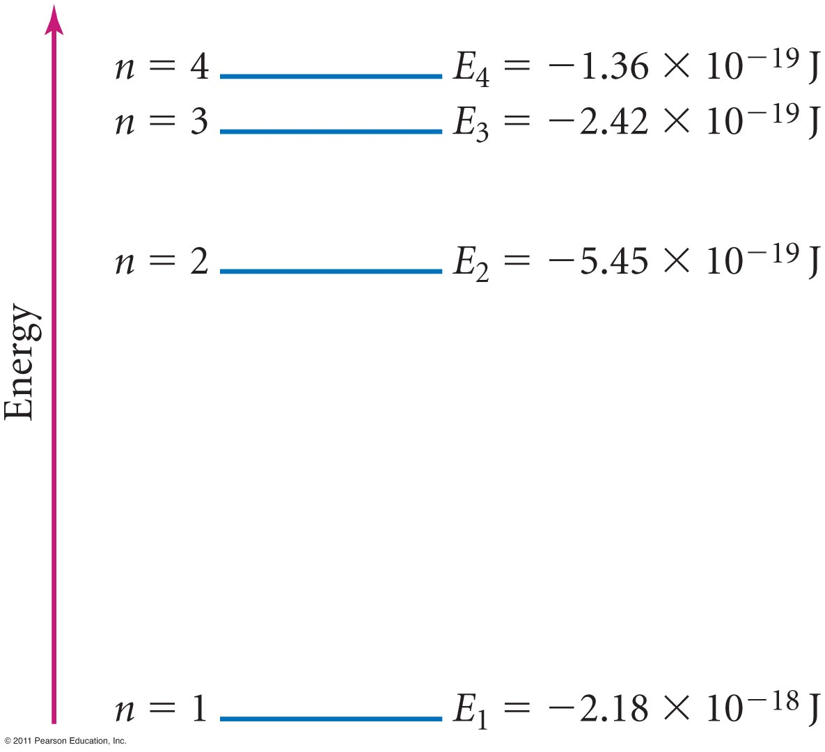
Principal Energy Levels in Hydrogen
Tro: Chemistry: A Molecular Approach, 2/e

Slide 4
Shells
These allowed energy levels or states are called shells
Each shell can possess a maximum number of electrons with this amount of energy (although for atoms with more than one electron – i.e., other than hydrogen – the situation becomes more complicated)

Slide 5
Occupancy of Shells
n =1, maximum occupancy = 2
n = 2, maximum occupancy = 8
n = 3, maximum occupancy = 18
The maximum occupancy helps explain the shape of the periodic table

Slide 6
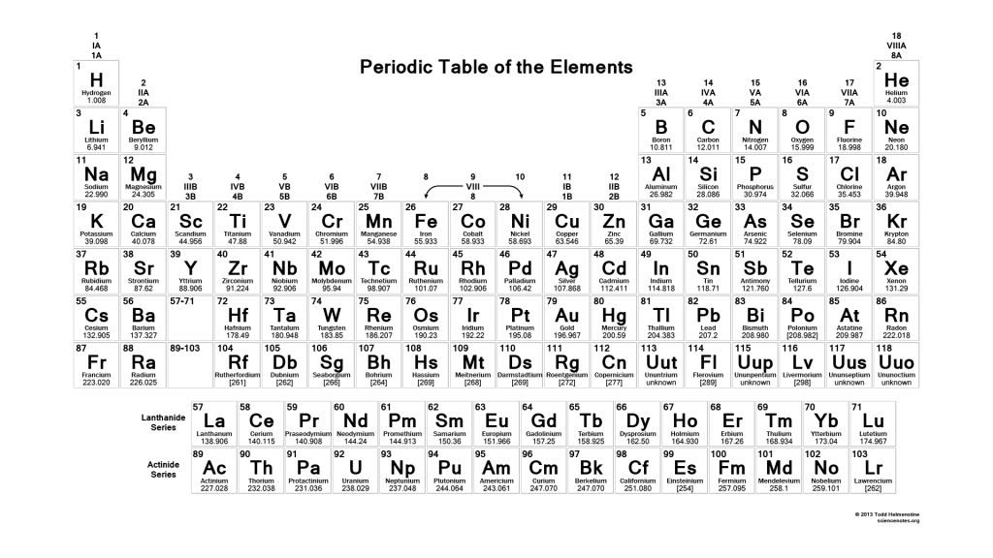
Periodic Table

Slide 7
Valence & Core Electrons
Electrons in the highest energy occupied shell are valence electrons
Electrons in the lower energy shells are core electrons
The chemistry of an atom is in large part determined by the number of valence electrons

Slide 8
Chemical Bonding
All substances are made from the just over 100 known elements
Chemical bonding – the joining of atoms to form new substances
Chemical bond - an interaction that holds two atoms together
The formation of chemical bonds involves the loss, gain or sharing of electrons

Slide 9
Theories of Chemical Bonding
The current understanding of chemical bonding has been the results of chemical experiments over about the last 150 years
Not all electrons are involved in bonding
Only electrons in the highest energy occupied shell – valence electrons - are involved in bonding

Slide 10
Periodicity & Core Electrons

Slide 11
Periodicity & Core Electrons
The periodic table can be used to determine the number of valence electrons
Elements in a group (vertical column of the periodic tale) have the “same” number of valence electrons (only if we ignore d and f orbital electrons)
The chemistry of an atom is in large part determined by the number of valence electrons so that elements in the same group have similar chemical properties
Group I, alkali metals, have one valence electron and similar chemical and physical properties – soft, low melting, and reactive with water

Slide 12
Explaining Chemical Reactivity
Atoms with the highest occupied energy state filled to capacity are extremely stable
Thus, inert gases or noble gases (Group 18) are extremely stable
Atoms of inert gases rarely form bonds
Atoms of group 18 have 8 valence electrons – the outermost shell of an atom is considered full when it contains 8 electrons

Slide 13
Group Numbers
IUPAC – 1-18
Old American and English systems – 1-8 (with A’s and B’s)
Old systems were designed to use the 8-electron rule – good for organic chemists (working primarily with C, H, N, and O) – bad for inorganic and physical chemists

Slide 14
Back to the Periodic Table

Slide 15
What Not to Do
Handout page 1

Slide 16
Back to Explaining Chemical Reactivity
Atoms tend to undergo ionization or chemical reactions to obtain the same number of electrons as atoms of inert gases, i.e. fill its highest energy occupied shell
H, He, and Li normally need 2 valence electrons – H₂, He, Li⁺
C, N, O, F, Ne, Na, Mg, and Al normally need 8 valence electrons – CH₄, NH₃, OH₂, HF, Ne, Na⁺, Mg²⁺, Al³⁺

Slide 17
What Not to Do
Handout page 2

Slide 18
The Key Word is “TEND”!
Guess we ignore Be (e.g., BeH₂ - 4 valence electrons) and B (e.g., BF₃ - 6 valence electrons, although does tend to form coordinate bonds to make compounds such as NH₃BF₃)
“Eight-electron rule” does not even generally hold for all 2nd row elements – (not Li, Be, and B)
3rd row elements in groups 15, 16, and 17 often do not obey 8 electron rule
Forget the rest of the table and the 8 electron rule as exceptions are the norm
Exceptions are even known for C, N, and O

Slide 19
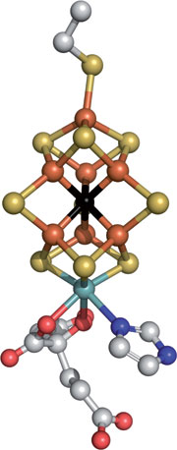
Carbon of FeMo Cofactor of Enzyme Nitrogenase
Carbon is 6-coordinate!

Slide 20
Ionic Bonding
An ionic bond is a bond that occurs when electrons are transferred from one atom to another
Ions are charged particles that form when atoms gain or loose electrons
Metal atoms with few valence electrons tend to loose electrons to most positive ions (fewer electrons than protons)
Nonmetal atoms tend to gain electrons and form negative ions (more electrons than protons)

Slide 21
What Not to Do
Handout pages 3 and 4

Slide 22
Covalent Bonding
A covalent bond forms when atoms share one or more electron
A molecule is the smallest unit of a substance that keeps all the physical and chemical properties of that substance
A molecule consists of two or more atoms joined by covalent bonds in definite ratios

Slide 23
Electron Dot Diagrams
After explaining the limitations that the use of these is limited primarily to 1st and 2nd row elements and some 3rd row elements and that exceptions exist even for these elements,
then electron dot diagrams are powerful rules in explaining the formulas of ionic compounds and covalent molecules

Slide 24
What Not to Do
Handout page 5

Slide 25
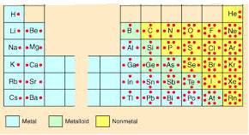
Electron Dot Diagrams
1
2
13
14
15
16
17
18

Slide 26
Lewis Dot Structures for Ions

Slide 27
Steps in Constructing Lewis Dot Structures for Molecules
1) Calculate total number of valence electrons
H₂O O 6 valence e⁻
2 x H 2 x 1 valence e⁻
8 valence e⁻

Slide 28
Steps in Constructing Lewis Dot Structures for Molecules
2) Place atoms around central atom (atom normally listed first except for H₂O)
3) Connect atoms with bonds

Slide 29
Steps in Constructing Lewis Dot Structures for Molecules
4) Complete octets around outer atoms
(except H gets only 2)
In this case, each hydrogen has two electrons from bonds

Slide 30
Steps in Constructing Lewis Dot Structures for Molecules
5) Count electrons used. Place any extra electrons on central atom.
2 bonds = 2 x 2 e⁻ = 4 e⁻
8 e⁻ - 4 e⁻ = 4 e-

Slide 31
Steps in Constructing Lewis Dot Structures for Molecules
6) If central atom has less than eight bonds, share an electron pair from outer atom with central atom to form multiple bonds until eight electrons are reached.

Slide 32
Some video and tutorial suggestions
Good tutorial on bond formation.
ttp://www.pbslearningmedia.org/asset/lsps07_int_covalentbond/
Good tutorial on ionic bonding.
http://www.pbslearningmedia.org/asset/lsps07_int_ionicbonding/
Excellent video on formation of ionic and covalent bonds without using planetary model.
http://www.diffen.com/difference/Covalent_Bonds_vs_Ionic_Bonds
Excellent video for Lewis dot structures.
http://www.pbslearningmedia.org/resource/3dae2ec9-414e-4ff7-a438-08cb24ebff9c/bonding-models-and-lewis-structures-crash-course-chemistry-24/
(Except quadruple, quintuple, and sextuple bonds exist).
Good video on bonding types.
http://www.pbslearningmedia.org/resource/fc1461da-20f4-41cb-9b2f-289a2f1839f1/types-of-chemical-bonds-crash-course-chemistry-22/
(A little too much depth, however).
Good video on last PS21 topic.
http://www.pbslearningmedia.org/resource/b687bee7-d854-4e6c-84b3-9acfeaf3bbfc/the-history-of-atomic-chemistry-crash-course-chemistry-37/
(Although puts more than 1 electron in Bohr model).

