Slide 1
Using Chemical Demonstrations to Demonstrate Concepts in Physical Science

Slide 2
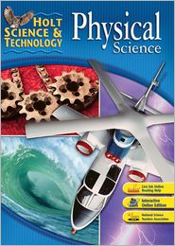
Holt Science & Technology: Physical Science

Slide 3
Chapter 14 Chemical Reactions Section 1 Forming New Substances
Section Outline
Chemical Reactions
Figure 1. Results of Chemical Reactions
-Signs of Chemical Reactions
Figure 2. Signs of Chemical Change
-A Change of Properties
Figure 3. No title
Bonds: Holding Molecules Together
-Breaking and Making Bonds
Figure 4. Reaction of Hydrogen and Chlorine
-New Bonds, New Substances

Slide 4
Chemical Reactions
Chemical reaction – Process in which one or more substances change to make one or more new substances
- The chemical and physical properties of the new substances differ from those of the original substances.

Slide 5
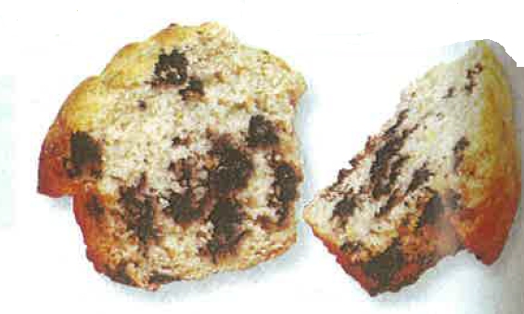
Demonstration 1 – Results of Chemical Reactions
When mixing baker powder in water, substances in the baking powder react to form bubbles of carbon dioxide (CO₂) gas. These bubbles give muffins their sponge-like texture.
sodium bicarbonate + cream of tartar
NaHCO₃ KHtartrate
H₂O + CO₂ + NaKtartrate

Slide 6
Signs of Chemical Reactions
Gas formation
Solid (precipitate) formation
Color change
Energy change
Light
Thermal energy (heat)
Electrical energy

Slide 7
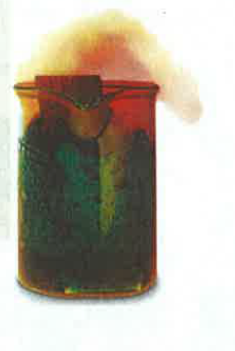
Demonstration 2 – Gas Formation
The chemical reaction in the beaker has formed a brown gas, nitrogen dioxide (NO₂). This gas is formed when a strip of copper is placed into nitric acid
Cu + 4 HNO₃ → Cu(NO₃)₂ + 2 NO₂ + 2H₂O

Slide 8
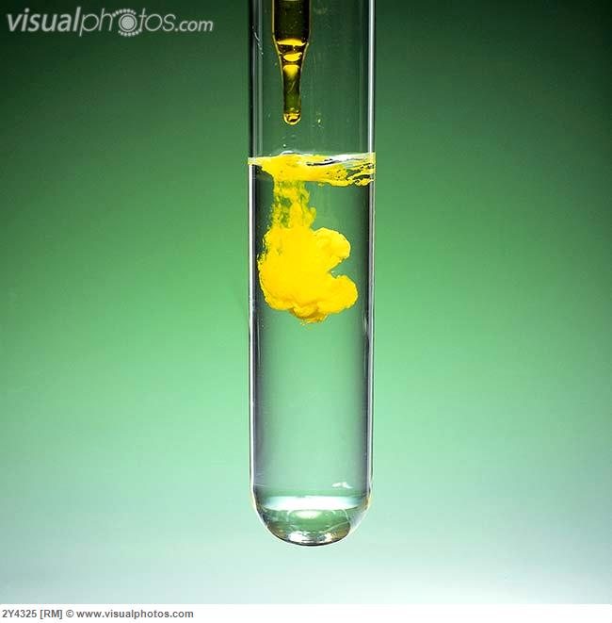
Demonstration 3 – Solid Formation
Potassium chromate added to a lead nitrate solution generates a bright yellow solid of lead chromate.
K₂CrO₄ + Pb(NO₃)₂ → PbCrO₄+ 2 KNO₃

Slide 9
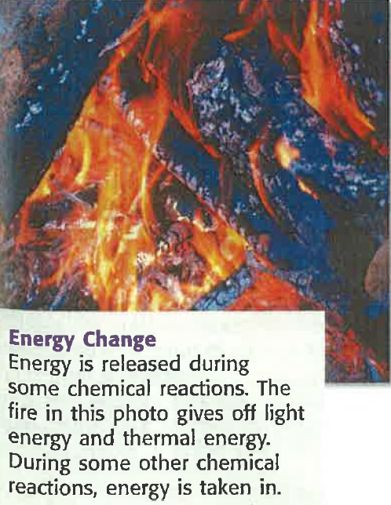
Energy Change

Slide 10
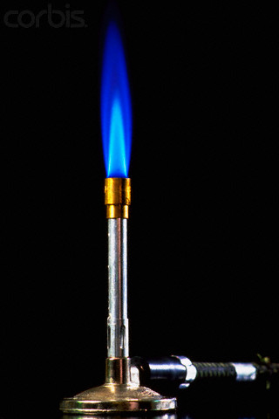
Demonstration 4 – Energy Change
Energy is released during some chemical reactions. The fire of a Bunsen burner gives off light energy and chemical energy. (An alcohol burner, candle, lighter, etc. could also be used, although reaction would change.)
CH₄ + 2 O₂ → CO₂ + 2 H₂O

Slide 11
Demonstration 5 – Heat Change
Hydrogen peroxide, H₂O₂, is unstable but decomposes very slowly. The decomposition reaction gives off heat. If Cu²⁺ ions are added (as a catalyst) to add aqueous solution of H₂O₂, the reaction proceeds rapidly and can become hot enough to boil the water.
If dishwashing detergent is added to the solution before the catalyst, then a version of the elephant toothpaste demonstration is produced.
2 H₂O₂ → O₂ + 2 H₂O

Slide 12
Demonstration 6 – Light
Snapping a glowstick breaks a small glass container in the glowstick, allowing chemicals in the glass container to mix with chemicals outside the glass (but inside the chamber of the glowstick).
The resulting reaction gives
off light.

Slide 13
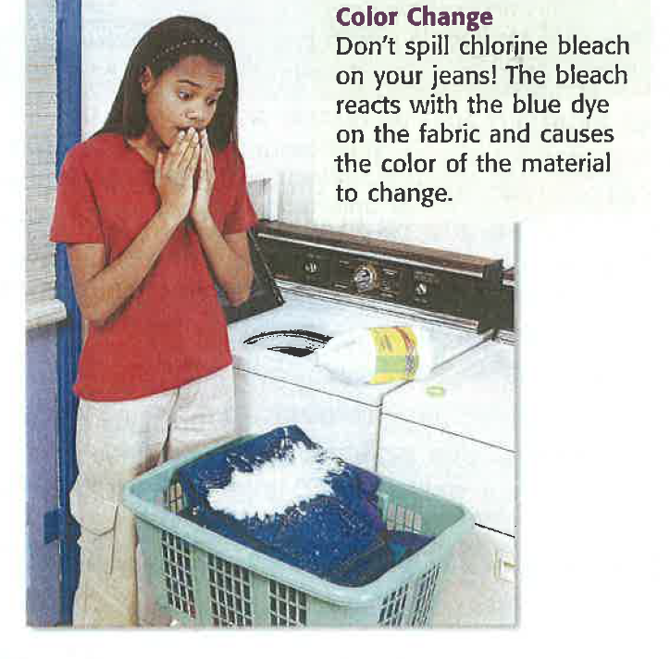
Demonstration 7 – Color Change
Don’t spill chlorine bleach on your jeans! The bleach reacts with the blue dye on the fabric and causes the color of the material to change.
Indigo + NaClO → no color
blue sodium
dye hypochlorite

Slide 14
Change of Properties
The signs discussed above do not guarantee that a reaction is happening.
The most important sign of a chemical reaction is the formation of new substances that have different properties.

Slide 15
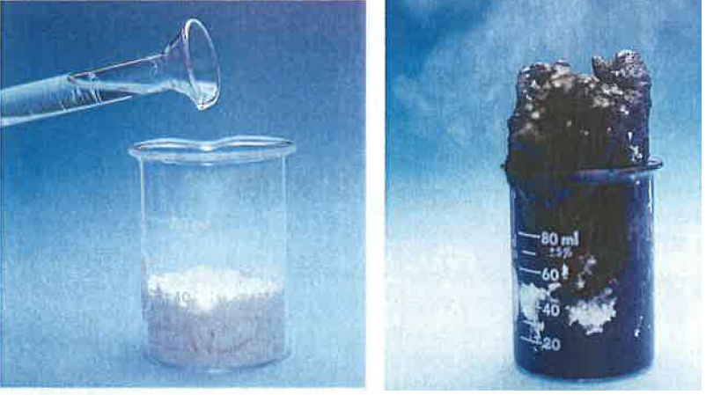
Demonstration 8 - Change of Properties
Starting materials, sugar and sulfuric acid, react to form bubbles as a gas is given off. The beaker gets very hot. New substances, very different from the starting materials form.
H₂SO₄
C₁₂H₂₂O₁₁ 12 C + 11 H₂O
Sucrose

Slide 16
Bonds: Holding Molecules Together
A chemical bond is a force that holds two atoms together in a molecule.
For a chemical reaction to take place, the original bonds must break and new bonds must form.

Slide 17
Breaking and Making Bonds
Molecules are always moving.
If the molecules bump into each other with enough energy, the chemical bond in the molecules break.
The atoms then rearrange, and new bonds form to make new substances.

Slide 18
Demonstration 9 -New Bonds, New Substances
Chlorine gas is a diatomic molecule – a molecule made of to atoms and is a yellow-green gas.
Hydrogen gas is also diatomic, made of two hydrogen atoms, and is a flammable colorless gas.

Slide 19
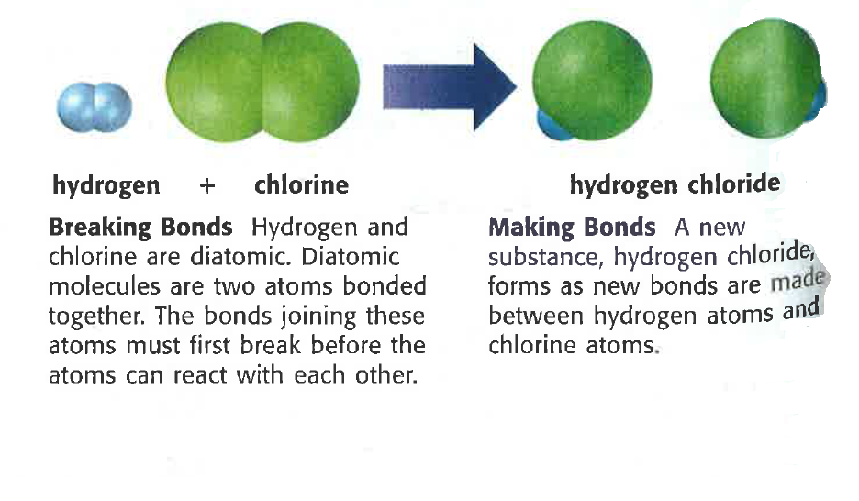
Demonstration 9 -New Bonds, New Substances (cont.)
When H₂ and Cl₂ react, bonds between the Cl atoms and bonds between the H atoms break.
A new substance, hydrogen chloride (HCl), is formed.
Hydrogen chloride is a nonflammable, colorless gas – different properties from both starting substances

Slide 20
Color Code for Atoms
White – hydrogen
Black – carbon
Blue – nitrogen
Red – oxygen
Green – chlorine
Yellow - sulfur

